Slide 1

MVC3
Jay Smith
Lead Programmer Analyst
Tyson Foods, Inc

Slide 2
About Me
Lead Programmer Analyst for Tyson Foods
Microsoft ASP NET MVP
Believes the Agile approach is the right way to create software
Suffers from Community-itis
Email: jay@jaysmith.us
Blog: http://jaysmith.us
Twitter: @JaySmith

Slide 3
Agenda
How to create a new ASP.NET MVC project
How to create ASP.NET MVC controllers and views
How to create a new database using the Entity Framework code-first paradigm
How to retrieve and display data
How to edit data and enable data validation

Slide 4
Demo
Creating a new ASP.NET MVC3 Project

Slide 5
Model View Controller
Classes that represent the data of the application and that use validation logic to enforce business rules for that data.

Slide 6
Model View Controller
Template files that are used to dynamically generate HTML responses

Slide 7
Model View Controller
Classes that handle in coming request to the application, retrieve model data, and then specify the view templates that return a response to the client

Slide 8
Demo
Create a Controller and view

Slide 9
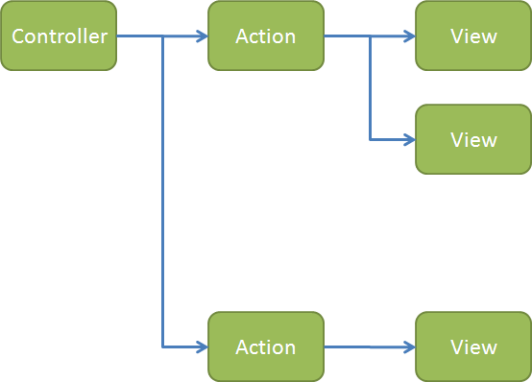

Slide 10
Demo
Entity Framework Code First

Slide 11
Demo
Entity Framework Code First

